Slide 1
Gray-Scale Morphology

Slide 2
Z² and Z³
set in mathematic morphology represent objects in an image
  binary image (0 = white, 1 = black) : the element of the set is the coordinates (x,y) of pixel belong to the object  Z²
gray-scaled image : the element of the set is the coordinates (x,y) of pixel belong to the object and the gray levels  Z³

Slide 3
Extension from Binary Morphology to Gray-Scale Morphology
deal with digital image function
  f(x,y) : the input image
  b(x,y) : a structuring element (a subimage function)
assumption : these functions are discrete
  (x,y) are integers
  f and b are functions that assign a gray-level value (real number or real integer) to each distinct pair of coordinate (x,y)

Slide 4
Gray Scale Morphology
In this morphology, the binary dilation, erosion, opening, closing are naturally extended to gray scale
extension: uses min or max operation
  gray scale dilation: surface of dilation of umbra
  gray scale dilation: maximum and a set of addition operations
  gray scale erosion: minimum and a set of subtraction operations

Slide 5


Gray Scale Dilation and Erosion: the concepts of TOP and UMBRA
top: top surface of A: denoted by
umbra of f: denoted by

Slide 6
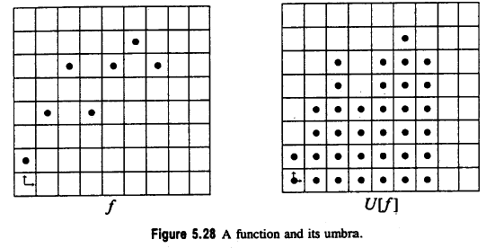
A function f and its Umbra U[f]
top surface of A:
Umbra are all points that are smaller or equal than the top surface

Slide 7
Gray-Scale Dilation

Slide 8
Gray-Scale Dilation with Max and shift
Shifts in both directions
dilation
D_{f} and D_{b} are the domains of f and b, respectively

Slide 9
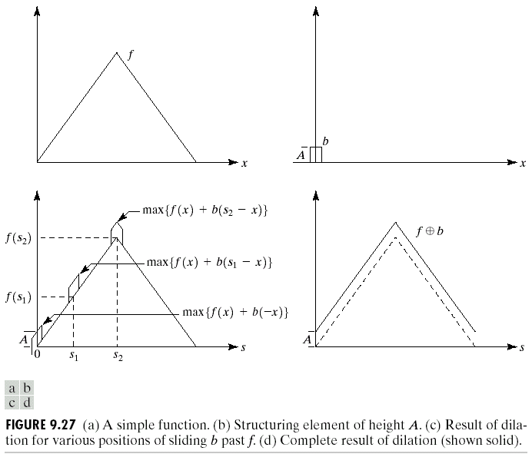
Gray-Scale Dilation
Simple function f
Structuring Element b of height A
Result of dilation of various positions of sliding b past f
Complete result of dilation shown in solid

Slide 10
Gray-Scale Dilation
D_{f} and D_{b} are the domains of f and b, respectively
condition that (s-x) and (t-y) have to be in the domain of f and (x,y) have to be in the domain of b is similar to the condition in binary morphological dilation where the two sets have to overlap by at least one element

Slide 11
Gray-Scale Dilation Characteristics
Gray Scale Dilation is similar to 2D convolution
  f(s-x) : f(-x) is simply f(x) mirrored with respect to the original of the x axis. the function f(s-x) moves to the right for positive s, and to the left for negative s.
  max operation replaces the sums of convolution
  addition operation replaces with the products of convolution
general effect of Gray Scale Dilation
  if all the values of the structuring element are positive, the output image tends to be brighter than the input
  dark details either are reduced or eliminated, depending on how their values and shapes relate to the structuring element used for dilation

Slide 12

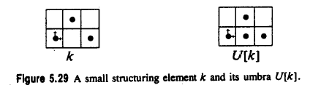
Gray Scale Dilation Using Umbra
gray scale dilation: surface of dilation of umbras
dilation of f by k: denoted by

Slide 13
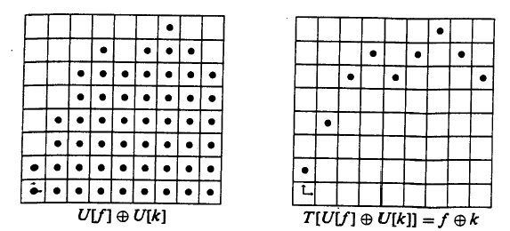
Gray Scale Dilation Using Umbra
umbra of k
Dilating the umbras of f and k
Finding the top surface T

Slide 14
Gray Scale Dilation with Umbra

Slide 15

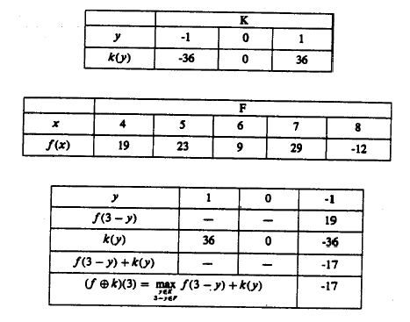
Calculations of Gray Scale Dilation Using Umbra
We want to calculate f dilation by K

Slide 16
Representation of K

Slide 17
Representation of F

Slide 18
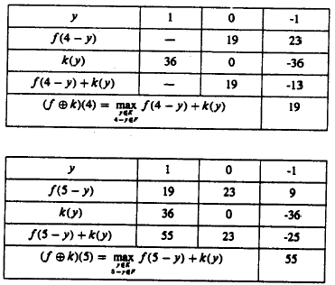
Calculations of Gray Scale Dilation

Slide 19
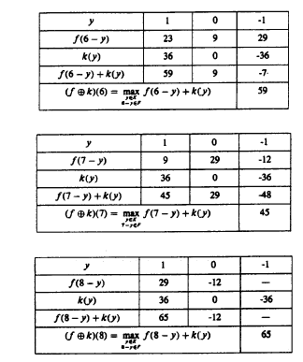

Slide 20
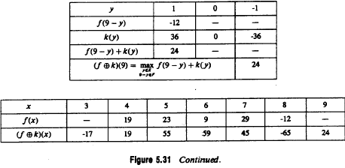

Slide 21
Representation of F dilation by k
F dilation by k

Slide 22
Gray Scale Erosion

Slide 23
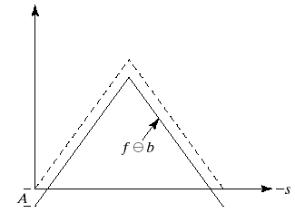
Gray Scale Erosion
erosion
condition (s+x) and (t+y) have to be in the domain of f and (x,y) have to be in the domain of b is similar to the condition in binary morphological erosion where the structuring element has to be completely contained by the set being eroded

Slide 24
Gray Scale Erosion
similar to 2D correlation
  f(s+x) moves to the left for positive s and to the right for negative s.
general effect
  if all the elements of the structuring element are positive, the output image tends to be darker than the input
  the effect of bright details in the input image that are smaller in area than the structuring element is reduced, with the degree of reduction being determined by the gray-level values surrounding the bright detail and by the shape and amplitude values of the structuring element itself

Slide 25
Dual property of Gray-scale Erosion and Dilation
gray-scale dilation and erosion are duals with respect to function complementation and reflection.

Slide 26
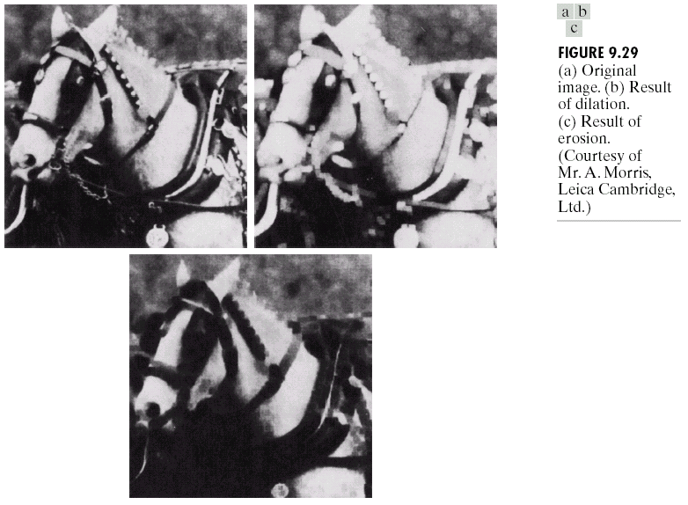
Example: Gray Scale Dilation and Erosion
result of dilation with a flat-top structuring element in the shape of parallelepiped of unit height and size 5x5 pixels
note: brighter image and small, dark details are reduced
result of erosion
note: darker image and small, dark details are reduced

Slide 27
Gray Scale Erosion with Umbra
gray scale erosion: surface of binary erosions of one umbra by the other umbra

Slide 28
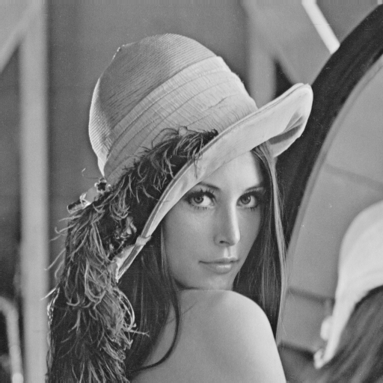
Original Lena Image
Dilation of Lena
=lena.im=

Slide 29

Dilated Lena Image
=lena.im.dil=

Slide 30
Structuring Elements:
Value=0
 | * | * | *
* | * | * | * | *
* | * | * | * | *
* | * | * | * | *
 | * | * | *

Slide 31
Gray Scale Erosion with Umbra

Slide 32
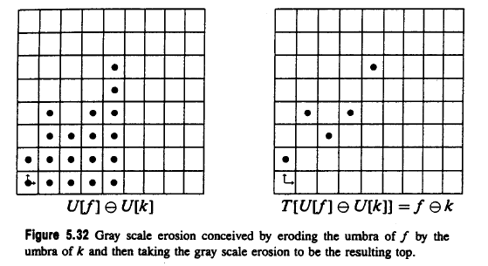
Gray Scale Erosion with Umbra

Slide 33

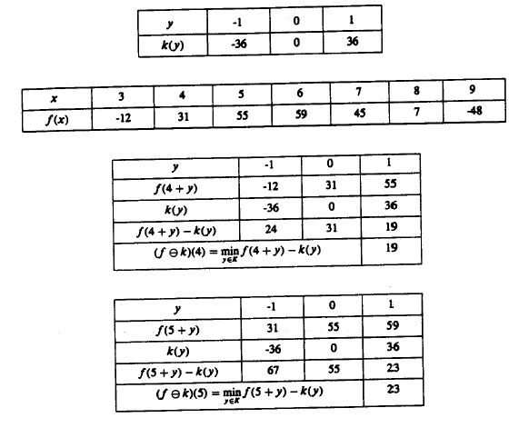
Gray Scale Dilation Erosion (cont’)

Slide 34
Gray Scale Dilation and Erosion (cont’)

Slide 35
Gray Scale Dilation and Erosion (cont’)

Slide 36
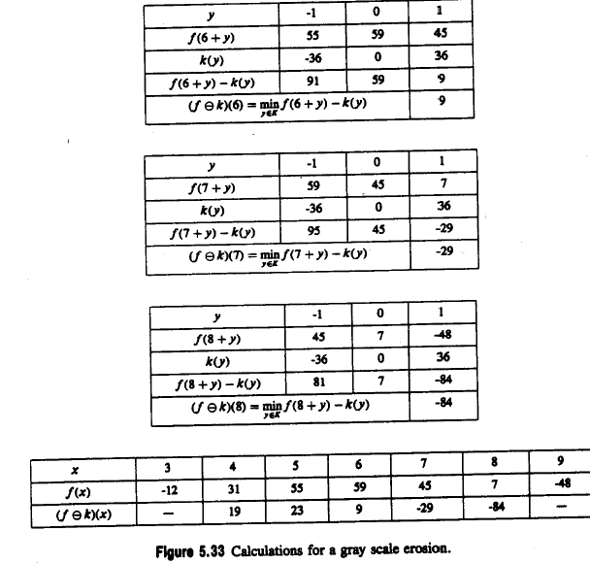
Calculations for a Gray Erosion

Slide 37
Gray Scale Erosion (cont’)

Slide 38
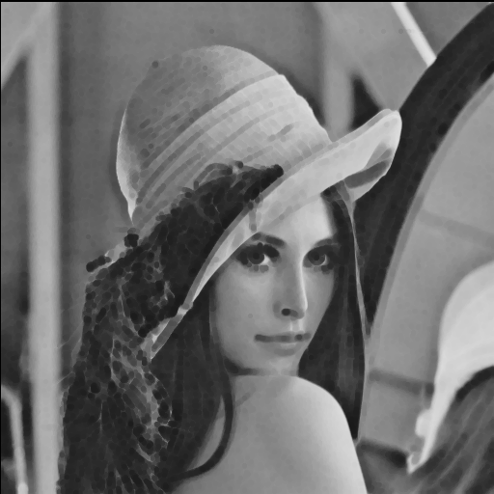
Gray Scale Erosion of Lena
=lena.im.ero=

Slide 39
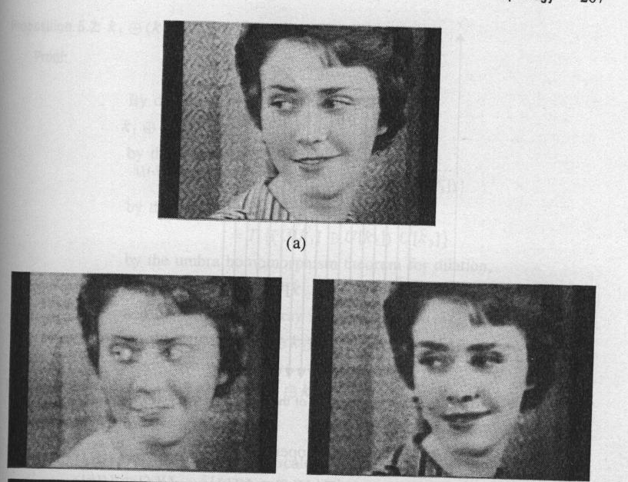
Gray Scale Dilation and Erosion (cont’)
original
erosion
dilation

Slide 40
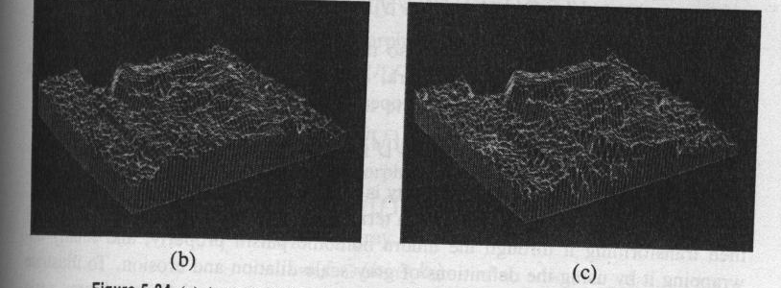
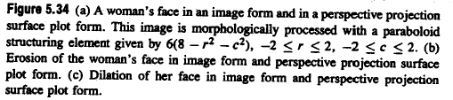
Gray Scale Dilation and Erosion (cont’)
Perspective projection surface plot forms

Slide 41


Umbra Homomorphism Theorems
surface and umbra operations: inverses of each other, in a certain sense
surface operation: left inverse of umbra operation
For dilation and for erosion

Slide 42

Umbra Homomorphism Theorems
Proposition 5.1
Proposition 5.2
Proposition 5.3

Slide 43
Gray Scale Opening and Closing

Slide 44
Gray Scale Opening and Closing
gray scale opening of f by kernel k denoted by f k
gray scale closing of f by kernel k denoted by f k
opening
closing

Slide 45
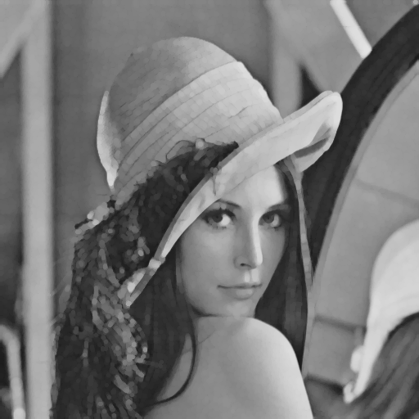
Gray Scale Opening of Lena
=lena.im.open=

Slide 46

Gray Scale Closing of Lena
=lena.im.close=

Slide 47

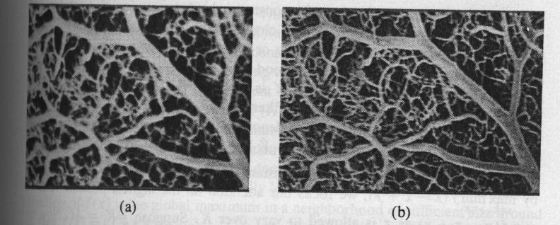
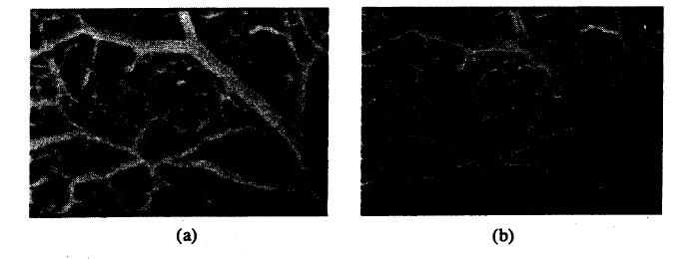
Duality of Gray Scale Opening and Closing
duality of gray scale, dilation➔ erosion duality of opening, closing
g
ORIGINAL IMAGE
Sharpened IMAGE

Slide 48
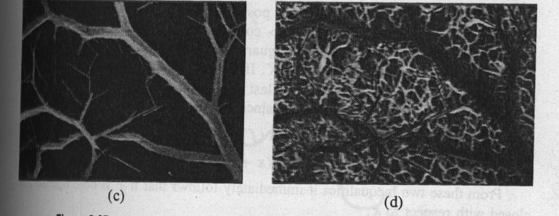
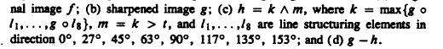
h

Slide 49
Openings, Closings and Medians
median filter: most common nonlinear noise-smoothing filter
  median filter: for each pixel, the new value is the median of a window
  median filter: robust to outlier pixel values leaves, edges sharp
median root images: images remain unchanged after median filter

Slide 50
Discuss hardware design of median filter and sorting

Slide 51
Gray Scale Opening

Slide 52
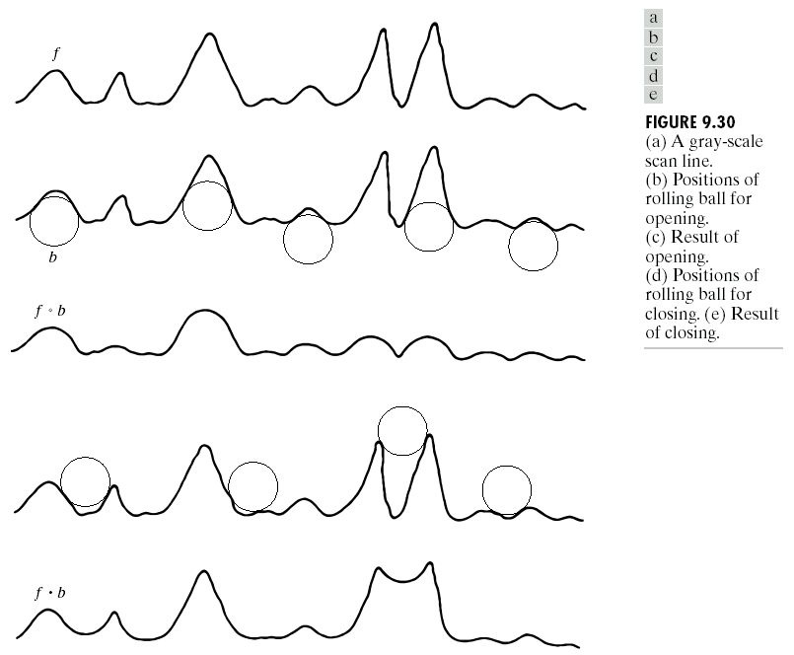
Opening and closing gray-level images
view an image function f(x,y) in 3D perspective, with the x- and y-axes and the gray-level value axis
a gray-scale scan line
positions of rolling ball for opening
result of opening
positions of rolling ball for closing
result of closing

Slide 53
Properties of Opening and Closing for Gray Level Images
dual property
opening operation satisfies
closing operation satisfies
note:
e↵r indicates that the domain of e is a subset of the domain of r, and also that e(x,y) ≤ r(x,y) for any (x,y) in the domain of e

Slide 54
Effects of opening
  the structuring element is rolled underside the surface of f
  all the peaks that are narrow with respect to the diameter of the structuring element will be reduced in amplitude and sharpness
  so, opening is used to remove small light details,
    while leaving the overall gray levels and larger bright features relatively undisturbed.
  the initial erosion removes the details, but it also darkens the image.
  the subsequent dilation again increases the overall intensity of the image without reintroducing the details totally removed by erosion

Slide 55
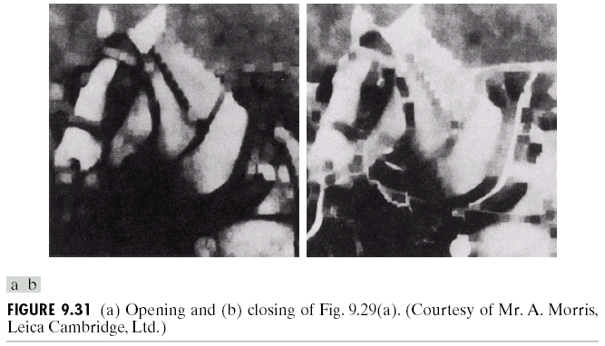
EFFECTS of OPENING: Example of Gray-Scale Opening
  the structuring element is rolled underside the surface of f
  all the peaks that are narrow with respect to the diameter of the structuring element will be reduced in amplitude and sharpness
  so, opening is used to remove small light details,
    while leaving the overall gray levels and larger bright features relatively undisturbed.
  the initial erosion removes the details, but it also darkens the image.
  the subsequent dilation again increases the overall intensity of the image without reintroducing the details totally removed by erosion

Slide 56
Gray Scale Closing

Slide 57
Effect of closing

Slide 58
EFFECTS of CLOSING: Example of Gray-Scale Closing
  the structuring element is rolled on top of the surface of f
  peaks essentially are left in their original form (assume that their separation at the narrowest points exceeds the diameter of the structuring element)
  so, closing is used to remove small dark details, while leaving bright features relatively undisturbed.
  the initial dilation removes the dark details and brightens the image
  the subsequent erosion darkens the image without reintroducing the details totally removed by dilation

Slide 59
Some Applications of Gray-scale Morphology
Morphological smoothing
Morphological gradient
Top-hat transformation
Textural segmentation
Granulometry
Note: the examples shown in this topic are of size 512x512 and processed by using the structuring element in the shape of parallelepiped of unit height and size 5x5 pixels

Slide 60
Gray Scale Morphological smoothing

Slide 61
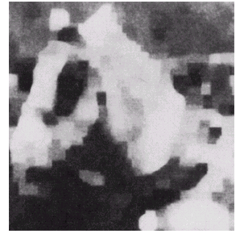
Morphological smoothing
perform an opening following by a closing
effect: remove or attenuate both bright and dark artifacts or noise

Slide 62
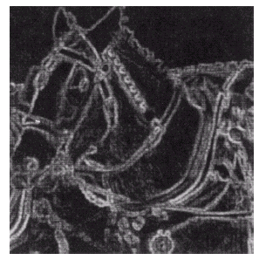
Morphological gradient
effect: gradient highlight sharp gray-level transitions in the input image.

Slide 63
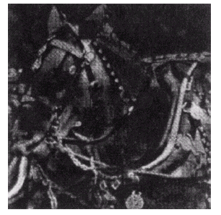
Top-hat transformation
effect: enhancing detail in the presence of shading
note: the enhancement of detail in the background region below the lower part of the horse’s head.

Slide 64
Textural segmentation

Slide 65
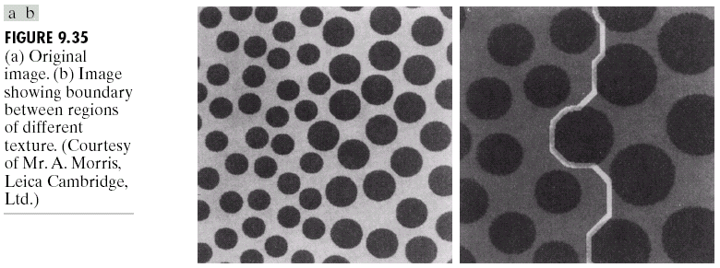
Textural segmentation
the region the right consists of circular blobs of larger diameter than those on the left.
the objective is to find the boundary between the two regions based on their textural content.

Slide 66
Textural segmentation
Original image
Image showing boundary between regions of different texture

Slide 67
Textural segmentation
white | black
Perform
  closing the image by using successively larger structuring elements than small blobs
    as closing tends to remove dark details from an image, thus the small blobs are removed from the image, leaving only a light background on the left and larger blobs on the right
  opening with a structuring element that is large in relation to the separation between the large blobs
    opening removes the light patches between the blobs, leaving dark region on the right consisting of the large dark blobs and now equally dark patches between these blobs.
  by now, we have a light region on the left and a dark region on the right, so we can use a simple threshold to yield the boundary between the two textural regions.

Slide 68
Gray Scale Granulometry

Slide 69
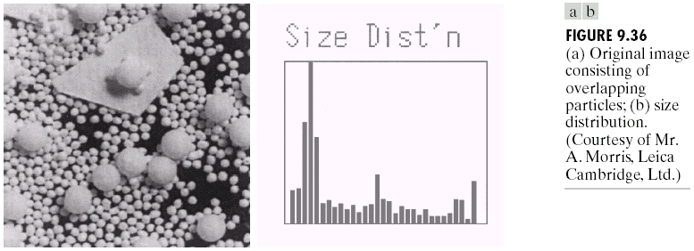
What is Granulometry?
determining the size distribution of particles in an image.
from the example, the image consists of light objects of 3 different sizes
the objects are not only overlapping but also cluttered to enable detection of individual particles

Slide 70
Granulometry
objects are lighter than background
Overlapping granules
Original image for granulometry
Size distribution of granules in the image

Slide 71
Procedure of Granulometry
Perform
  opening with structuring elements of increasing size on the original image
  the difference between the original image and its opening is computed after each pass when a different structuring element is completed
  at the end of the process, these differences are normalized and then used to construct a histogram of particle-size distribution
idea: opening operations of a particular size have the most effect on regions of the input image that contain particles of similar size.

Slide 73
Sources
傅楸善 & 王林農
r94922081@ntu.edu.tw
Morris

